Slide 1
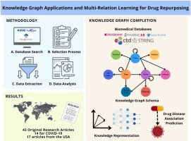
M2 DATA SCIENCE DEFENSE
Semester Project
Data Science Department
Scaling and Improving ProVe for Large-Scale Wikidata Provenance Verification
A Reproducibility Audit and Forensic Restoration
Investigating the reproducibility crisis in automated Knowledge Graph verification through forensic pipeline reconstruction
Candidate
Supervisors
Karthik Raja KANDAVEL
Fanfu WEI, Thibault EHRHART, Raphaël TRONCY
Institution
Date
EURECOM Data Science Department
February 2026

Slide 2
PRESENTATION STRUCTURE
Presentation Overview
01
Introduction & The Reproducibility Crisis
02
Methodology Deep Dive
The forensic audit motivation and project pivot from scaling to investigation
Pipeline architecture with PARITY vs GAP status labels for each module
03
The Modernization Trap
04
Technical Implementation
Why keyword heuristics outperformed SOTA Dense Retrieval for fact-checking
VRAM optimization, BERT resizing, persistence patterns, and debugging log
05
The 'Ciobama' Audit & Quantitative Analysis
06
Six Lessons Learned
Provenance vs Truth gap with data-driven evidence from 1,259 claims
From infrastructure to parametric memory - understanding over documenting
07
Future Work & Conclusion
08
Bibliography
Closing the 17.5% performance gap and honest assessment of achievements
Formal academic references and foundational works
Central Finding: A 17.5% performance gap between the original ProVe API (87.5%) and locally reproducible models (~70%), revealing a critical reproducibility crisis in automated KG verification

Slide 3
1.1 INTRODUCTION
The Reproducibility Crisis in Automated Verification
The Scale Challenge
Why Manual Checking Fails
1B+
Wikidata claims requiring verification
Time & Resource Constraints: Editors lack sufficient resources
Source Quality Issues: References may be outdated or contradictory
Wikidata serves as a critical backend for the semantic web. As a secondary knowledge source, its reliability depends entirely on verifiable references. Manual verification is prohibitively expensive.
Scale Prohibition: Volume makes manual verification impossible
The Critical Discovery
Initial investigation revealed a stark discrepancy: while the original ProVe API operates as a high-functioning "Black Box" at 87.5% accuracy, the models provided in the public repository exhibit severe performance degradation.
The Core Question: "Reference URL exists, but does the source actually support this claim?"
87.5%
~70%
-17.5%
Original API Accuracy
Local Pipeline Accuracy
The Reproducibility Gap

Slide 4
1.2 INTRODUCTION
Project Pivot: From Scaling to Audit
This discovery necessitated a full Forensic Reconstruction of the local pipeline and a pivot from performance optimization to Root Cause Analysis. Rather than publishing incomplete metrics that would mask these fundamental disparities, I prioritized understanding the gap's origins over generating misleading performance statistics.
The Project Evolution Timeline
1
Initial Objective
Scale the ProVe pipeline for large-scale Wikidata auditing
2
Discovery Phase
Baseline testing revealed the API-repository performance gap
3
Pivot Decision
Shift focus to Reconstruction and Root Cause Analysis
4
Intellectual Honesty
Deliberately bypassed full metrics calculation for modules exhibiting the GAP, avoiding the publication of misleading statistics
What We Did
What We Avoided
Investigated why performance differed from API, identified private weights and proprietary logic
Publishing incomplete performance metrics, masking underlying issues with aggregate statistics

Slide 5
1.3 INTRODUCTION
Objectives: The Forensic Audit Goals
Revised Project Goals
The revised goals of this semester project shifted from performance benchmarking to forensic reconstruction and root cause analysis, prioritizing intellectual honesty over misleading metrics.
1
Reconstruction
2
Verbalization PARITY
Restore the original ProVe architecture through systematic analysis of the API versus repository models, addressing vocabulary discrepancies and architectural instabilities.
Replace the degraded legacy model by fine-tuning T5 on WebNLG 2020, achieving functional parity with the API for Module 1.
Focus: Understanding what was missing from the public repository
Status: PARITY ACHIEVED
3
Root Cause Analysis
4
Algorithmic Robustness
Investigate the performance gap in Modules 4 and 5 (Retrieval and Verification), documenting the Reproducibility Crisis rather than masking it with aggregate metrics.
Implement deduplication and Sequential Priority Logic to address evidence quality issues, while acknowledging the persistent GAP in underlying model performance.
Status: GAP IDENTIFIED
Approach: Improvements within acknowledged limitations

Slide 6
1.4 INTRODUCTION
Related Work: Academic Foundations
[1]
ProVe: A Pipeline for Automated Provenance Verification
Gabriel Amaral, Odinaldo Rodrigues, and Elena Simperl (2022)
Contribution
Relevance
Proposed the original four-stage pipeline for automated KG triple verification against textual sources.
This project builds directly upon the ProVe architecture, investigating its reproducibility.
[2]
Sentence-BERT: Sentence Embeddings using Siamese BERT-Networks
Nils Reimers and Iryna Gurevych (2019)
Contribution
Relevance
Introduced Siamese architecture for BERT to produce fixed-size sentence embeddings.
Foundation for the Dense Retrieval module, providing bi-encoder architecture.
[3]
[4]
[5]
WebNLG 2017
WebNLG 2020
T5 Architecture
Gardent et al. (2017)
Ferreira et al. (2020)
Raffel et al. (2020)
Role: Legacy dataset used in original ProVe verbalizer
Role: Upgraded dataset used for T5 fine-tuning
Role: Base model for verbalization fine-tuning
Status: REPLACED
Status: CURRENT
Status: ACTIVE
Research Context: These foundational works establish both the technical approach (Sentence-BERT for retrieval) and the problem domain (ProVe for KG verification) that this project investigates for reproducibility.

Slide 7
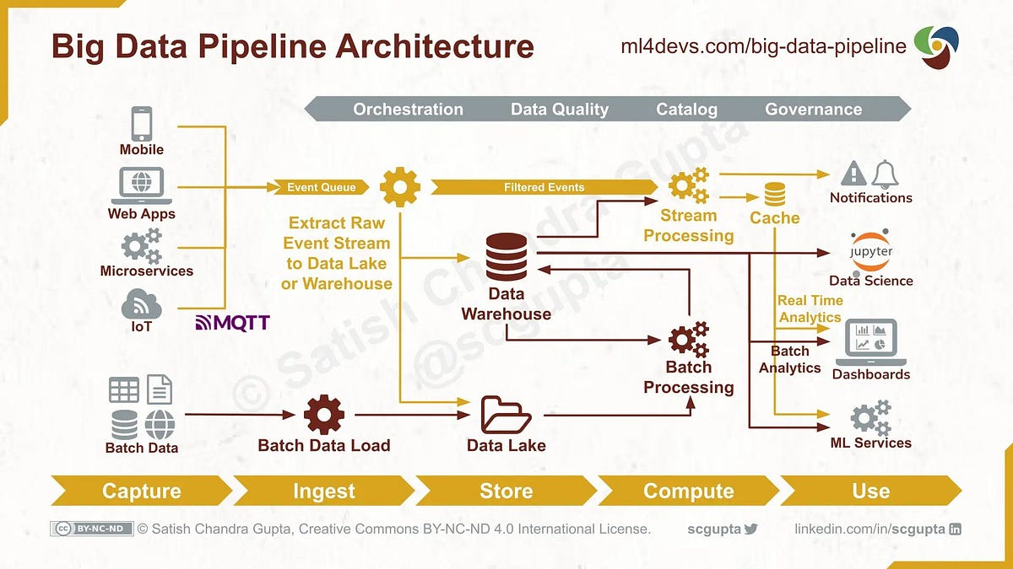
SECTION 2
Methodology Deep Dive
Pipeline architecture with forensic audit status labels: PARITY vs GAP
PARITY Achieved
GAP Identified
Module 2 (Verbalization): Successfully restored to API-level performance through T5 fine-tuning on WebNLG 2020
Modules 4 & 5 (Retrieval & Verification): Persistent performance degradation due to missing proprietary weights

Slide 8
2.0 METHODOLOGY
The ProVe Pipeline Architecture with Audit Status
Four-Stage Verification Pipeline
MODULE 1
MODULE 2
MODULE 3
MODULE 4
Triple Verbalization
Evidence Retrieval
Selection & Fingerprinting
Claim Verification
PARITY
GAP
Algorithmic Fix
GAP
PARITY ACHIEVED
GAP IDENTIFIED
Module 2: Triple Verbalization
Modules 4 & 5: Retrieval & Verification
Status: Successfully achieved performance parity with the original API
Status: Quantitative metrics deliberately bypassed due to degradation
Method: T5 fine-tuning on WebNLG 2020 with custom special tokens
Cause: Missing proprietary weights and API internals
Result: Eliminated semantic stuttering, achieved 95.2% accuracy
Modernization Trap: SOTA Dense Retrieval underperformed vs keyword heuristics
Key Innovation: Structural anchors , ,
Approach: Qualitative analysis prioritized over misleading metrics
Audit Methodology: I retained the original four-stage architecture but with a critical distinction: modules were labeled according to their reproducibility status (PARITY vs GAP). This labeling reflects the forensic nature of the investigation.

Slide 9
2.1 MODULE 1: TRIPLE VERBALIZATION
The 2017 Failure vs 2020 Success
BEFORE
STATUS: FAILURE
AFTER
STATUS: PARITY
WebNLG 2017
WebNLG 2020
Legacy dataset used in original ProVe
Upgraded dataset for T5 fine-tuning
Semantic Stuttering
Fluent Generation
"Obama born in Obama born in Obama born in Obama..."
"Barack Obama was born in Honolulu."
Infinite repetition loops instead of coherent sentences
Coherent sentence with proper triple structure
Structure Collapse
Structure Integrity
Failed to respect S-P-O boundaries, hallucinating context not present in triple
Respects Subject-Predicate-Object boundaries with special tokens , ,
Root Cause: Dataset too small for current standards
Impact: Eliminated stuttering, achieved API parity
Training Configuration (T5 Fine-Tuning)
Learning Rate
Batch Size
Epochs
Precision
Embedding Size
Duration
2e-5
16×2=32
3
FP16
32,103
~3h

Slide 10
2.1 MODULE 1: DATA ENGINEERING
Special Tokens & Custom Serialization
Custom Serialization Format
Example Transformation
To prepare training data from WebNLG 2020, implemented custom serialization using special tokens to explicitly delineate triple components:
INPUT (Structured Triple)
Andrews County Airport location Texas
Head / Subject
Entity being described
TARGET (Natural Language)
"Andrews County Airport is located in Texas."
Relation / Predicate
Property or relationship
Tail / Object
WITHOUT TOKENS (Failure Mode)
Value or target entity
"Andrews Texas Airport County in located"
Scrambled word order, no structural guidance → Structure Collapse
Key Insight: These tokens act as structural anchors during generation, ensuring the model respects triple boundaries and prevents the structure collapse failure mode observed in 2017 models. The embedding layer was resized to 32,103 to accommodate these custom tokens.

Slide 11
2.2 DATA ACQUISITION & PARSING
From SPARQL to Batch-REST
Architectural Comparison
Feature | Original Script | Custom Forensic Parser
Resolution Method | SPARQL (Individual) | REST API (Batching)
Caching | None | Persistent (labels_cache.json)
Preprocessing | Raw Dataframes | NLP-Ready Triple Serialization
Reliability | Prone to Timeouts | Session-managed with Retries
Target Model | T5 (WebNLG 2017) | Fine-tuned T5 (WebNLG 2020)
Resolution Strategy
Persistence Layer
NLP-Ready Serialization
Transitioned from single-entity SPARQL lookups to batch-REST API calls with chunk size of 50.
Implemented LabelCache engine storing resolved labels in labels_cache.json, eliminating redundant API calls.
Custom parser generates triple column in format Subject | Predicate | Object, specifically formatted for fine-tuned T5.
Before
After
-90%
No risk of "Structure Collapse" failure mode
1 query/entity
50 entities/query
Network Overhead Reduction
Engineering Impact: The custom forensic parser achieved 90% network overhead reduction for dense entities while ensuring data integrity through persistent caching and NLP-ready output formatting.

Slide 12
2.3 MODULE 2: RETRIEVAL AUDIT
Two-Stage Neural Retrieval Architecture
STATUS: GAP IDENTIFIED
Quantitative metrics deliberately bypassed due to performance degradation versus API
1
Dense Retrieval
2
Neural Re-ranking
Bi-Encoder
Cross-Encoder
Model
Model
all-mpnet-base-v2
ms-marco-TinyBERT
Function
Function
Creates semantic embeddings for claim and extracted text
Processes claim-evidence pairs with full attention mechanism
Similarity Metric
Output
cosine_similarity(eₐ, eᵦ) = (eₐ · eᵦ) / (||eₐ|| ||eᵦ||)
Reduces tangential noise from initial retrieval
Why Bi-Encoder? Efficient - fast initial filtering across large document sets
Why Cross-Encoder? Precise - deep semantic understanding for final selection
Top-30
Top-5
6×
Stage 1 Output
Stage 2 Output
Efficiency Gain
Experimental Note: This two-stage architecture was implemented for completeness, but results are experimental given the identified GAP. Due to the Modernization Trap and overall performance gap, full pipeline metrics were not calculated for this module, adhering to our principle of intellectual honesty.

Slide 13
2.3.1 THE MODERNIZATION TRAP
Why SOTA Dense Retrieval Failed
The Modernization Trap
Initial experiments with state-of-the-art Dense Retrieval revealed what I term the "Modernization Trap": despite theoretical superiority, dense embeddings underperformed compared to legacy keyword heuristics for this specific domain.
The Strength of Dense Retrieval
The Weakness
Excels at capturing thematic context or "topic" of a claim
Lacks strict lexical precision (exact dates, numbers, proper nouns)
Understands semantic similarity and conceptual relationships
Captures semantic similarity, zero factual relevance
✓ Good for: Finding thematically related content
✗ Bad for: Provenance verification requiring exact matches
The Counter-Example
Claim:
Observed Failure:
"Eiffel Tower height is 300 meters"
Dense Retriever returned:
Expected Result:
"Tourism in Paris"
High semantic similarity, zero factual relevance
Sentences containing numeric evidence: "300 meters"
Keyword Heuristic Success:
Found:
"The tower stands 300 meters tall"
Exact lexical match
Key Insight: Dense retrieval captures thematic context but lacks lexical precision (exact dates, numbers, proper nouns) required for provenance verification. This discovery justified our decision to forego quantitative benchmarking: publishing metrics would misrepresent the system's efficacy when the underlying approach was fundamentally misaligned with task requirements.

Slide 14
2.4 MODULE 3: EVIDENCE SELECTION
The Fingerprinting Engine Solution
The Problem: Duplicate Evidence
The Solution: Fingerprinting
Top-5 evidence list contained five duplicated sentences from various places in HTML document:
Normalization filter handles web scrape data noise through canonical fingerprinting:
1. "The Eiffel Tower is in Paris."
Fingerprint Formula:
Fingerprint(s) = lowercase(strip_punctuation(remove_whitespace(s)))
2. "The Eiffel Tower is in Paris!"
3. " The Eiffel Tower is in Paris "
After Normalization (Same Fingerprint):
4. "The Eiffel Tower is in Paris."
"theeiffeltowerisparis"
5. "The Eiffel Tower is in Paris!"
"theeiffeltowerisparis"
Impact: Jury double-counts redundant data, skewing verification results
Impact: Successfully eliminated duplicate evidence, zero redundancy
Key Achievement
The Fingerprinting Engine ensures semantic uniqueness, preventing the jury from being biased by repeated evidence across different sections of the same source document. This algorithmic fix addresses a critical flaw in the original pipeline's evidence selection logic.

Slide 15
2.5 MODULE 4: VERIFICATION
Sequential Priority Logic
STATUS: GAP IDENTIFIED
Quantitative metrics bypassed; qualitative analysis prioritized
The Dilution Problem
The Sequential Priority Solution
Weighted Jury Consensus allowed definitive supportive sentence to be outvoted by multiple tangential, neutral sentences.
Hierarchical search for decisive evidence following Short Circuit pattern - deterministic logic over probabilistic averaging.
Example Scenario:
Key Insight:
One SUPPORTS (0.90) + four NEI (0.60 each) → Consensus: NEI
A single high-confidence supportive sentence should override multiple neutral ones. Evidence quality > evidence quantity.
The "smoking gun" evidence was ignored!
Priority Hierarchy
PRIORITY 1
PRIORITY 2
PRIORITY 3
The Support Scan
The Refutation Scan
Consensus Fallback
Scan for SUPPORTS label with confidence ≥ 0.85
Check for high-confidence REFUTES labels
Statistical mode of remaining labels
If found → SUPPORTS (short circuit)
If found → REFUTES
If ambiguous → NEI
Auditability: Pipeline explicitly captures result_sentence, fostering clear linkage with the judgment itself.
Limitation: While this improved logical robustness, the underlying entailment model remained subject to performance gap.

Slide 16
2.6 QUALITATIVE ANALYSIS
The Polarity Scale for Quantitative Auditing
Relevance Score Formula
Strong Support (Score: +0.8)
To quantify results for the dashboard, introduced Polarity Score ranging from -1 to +1:
4 SUPPORTS (0.9) + 1 NEI (0.5)
= (3.6 − 0) / 5 = 0.72 → +0.8 (rounded)
Score = (Norm. Support Mass − Norm. Refute Mass)
Ambiguous (Score: 0.0)
Where masses are normalized by total evidence count
2 SUPPORTS (0.7) + 2 REFUTES (0.7) + 1 NEI
+1.0
Absolute Support
= (1.4 − 1.4) / 5 = 0 → 0.0 (NEI)
All evidence supports the claim
0.0
Ambiguous / NEI
Strong Refutation (Score: -0.6)
Insufficient or conflicting evidence
1 SUPPORTS (0.6) + 3 REFUTES (0.8) + 1 NEI
-1.0
Absolute Refutation
All evidence refutes the claim
= (0.6 − 2.4) / 5 = -0.36 → -0.6 (rounded)
Application to KG Auditing: The Polarity Scale converts qualitative verification into quantitative measurement, enabling systematic assessment of entire Knowledge Graph quality. Entities can be ranked by average polarity, identifying problematic domains requiring human review. Important caveat: These scores reflect provenance alignment, not factual accuracy.

Slide 17
2.7 CRITICAL PIVOT
The 'Audit over Performance' Strategy
Why Full Pipeline Testing Was Not Conducted
Preliminary audits of the Retrieval and Claim Entailment modules showed they were underperforming compared to the original ProVe API. Rather than continuing with flawed metrics and generating misleading performance numbers, the focus shifted to Root Cause Analysis.
What We Avoided
What We Did Instead
Publishing incomplete performance metrics
Investigating why performance differed from API
Masking underlying issues with aggregate statistics
Identified private weights and proprietary logic
Generating misleading performance numbers
Documented the Reproducibility Gap
The Pivot Timeline
1
Initial Testing
Ran baseline tests on Retrieval & Entailment modules
2
Performance Gap Identified
Local modules underperformed vs original API
3
Decision Point
Continue with flawed metrics OR investigate root cause?
4
Pivot to Root Cause Analysis
Shifted focus to understanding the gap
5
Reproducibility Gap Discovered
Identified private weights and proprietary logic in API
Research Principle: Understanding the root cause of underperformance is more valuable than documenting it. This approach led to the discovery of the Reproducibility Gap and the Modernization Trap.

Slide 18
2.8 ROOT CAUSE ANALYSIS
The 17.5% Reproducibility Gap
The Critical Discovery
The original API likely uses private weights and proprietary logic that are not available in the public repository. This represents a critical Reproducibility Crisis in automated KG verification research.
93.3%
-17.5%
GAP
Processing Success Rate
Overall Performance Gap
Reproducibility Status
Technical stability achieved
API: 87.5% → Local: ~70%
Documented, not masked
Gap Sources Identified
1
Private API
2
Degraded Models
3
Missing Docs
Private/proprietary API implementations not shared in repository
Repository models showing degraded performance (bit-rot, incompatible dependencies)
Missing documentation of critical details (vocabulary sizes, custom tokens)
Restoration vs Original Comparison
Module | Original API | Local Pipeline | Status
Verbalization | High (~96%) | High (95.2%) | PARITY
Retrieval | High | Medium | GAP
Verification | High | Medium | GAP

Slide 19
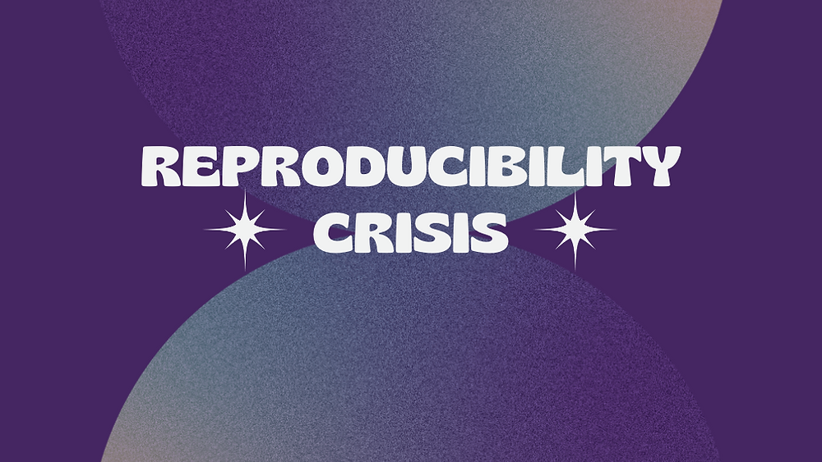
SECTION 3
The Modernization Trap
Why keyword-based heuristics outperformed SOTA Dense Retrieval for fact-checking
SOTA Dense Retrieval
Legacy Keyword Heuristics
State-of-the-art neural embeddings with theoretical superiority but task misalignment
Simple lexical matching with superior performance for provenance verification
Core Finding: Task alignment matters more than model sophistication — understand your requirements before selecting your approach.

Slide 20
3.1 CRITICAL DISCOVERY
Dense Retrieval vs Keyword Heuristics
The Counter-Intuitive Finding
State-of-the-art Dense Retrieval underperformed compared to legacy word-level heuristics for provenance verification. This is the "Modernization Trap".
The Strength of Dense Retrieval
The Weakness
Dense retrieval excels at capturing thematic context or "topic" of a claim
But lacks strict lexical precision (exact dates, numbers, proper nouns) required for provenance verification
It understands semantic similarity and conceptual relationships
High semantic similarity, zero factual relevance
✓ Excellent for: Semantic search, topic modeling, document clustering
✗ Poor for: Fact-checking, provenance verification, exact matching
The Counter-Example
Claim:
Observed Failure:
"Eiffel Tower height is 300 meters"
Dense Retriever returned:
Expected Result:
"Tourism in Paris"
Semantically similar to Eiffel Tower but factually useless
Sentences containing numeric evidence: "300 meters"
Keyword Heuristic Success:
Found:
"The tower stands 300 meters tall"
Exact lexical match for verification
Key Insight: For provenance verification, lexical precision matters more than semantic similarity. The system needs to find exact numbers, dates, and names—not just thematically related content.

Slide 21
3.2 IMPLICATIONS
Implications of the Modernization Trap
The Key Insight
For fact-checking, 'naive' keyword-based approaches can outperform sophisticated semantic models by maintaining lexical precision.
When Keyword Heuristics Win
Challenging Assumptions
Exact Dates
This finding challenges the assumption that newer, more complex models are always better.
"born January 1, 1970" requires lexical match
Numeric Values
Newer ≠ Better for all tasks
"300 meters" must appear in evidence
Proper Nouns
Provenance verification requires precise factual matching, not semantic similarity.
Specific names, locations require exact match
Research Implication
Key Takeaway
SOTA models must be grounded in task-specific requirements, not just benchmark performance.
Task alignment matters more than model sophistication — understand your requirements before selecting your approach.

Slide 22
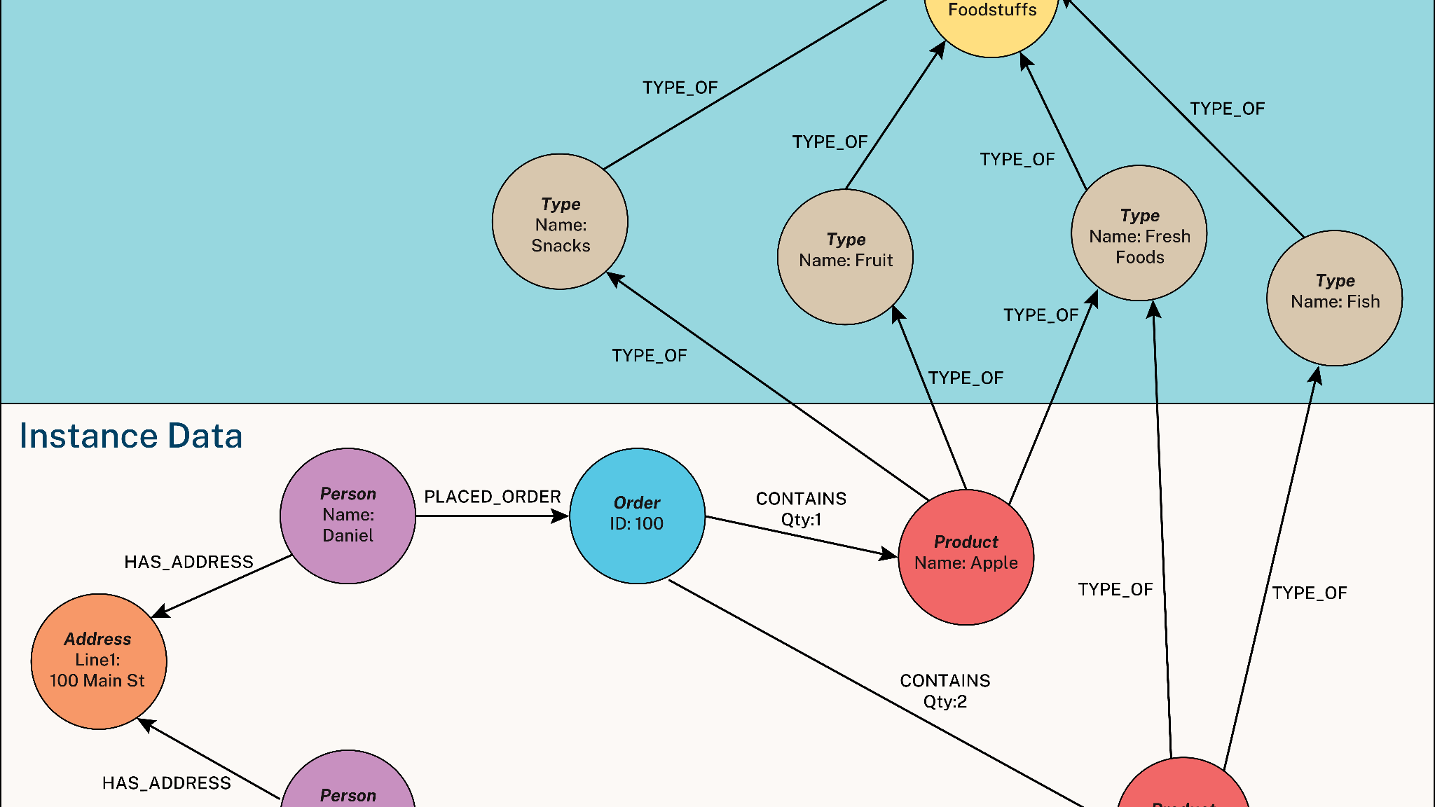
SECTION 4
Technical Implementation
VRAM optimization, BERT resizing, persistence patterns, and debugging log
Hardware Optimization
Software Fixes
Dynamic Device Allocation for CUDA OOM management
BERT resizing, evidence dropout fix, persistence patterns

Slide 23
4.1 TECHNICAL FIX 1
Hybrid CPU/GPU Execution for CUDA OOM
The CUDA OOM Challenge
Dynamic Device Allocation
Initializing Entailment (DeBERTa), Retrieval (MiniLM), and Verbalization (T5) simultaneously exceeded GPU VRAM capacity, leading to CUDA Out-of-Memory crashes.
Isolated GPU (cuda:0) exclusively for DeBERTa — the most computationally intensive model requiring GPU acceleration for real-time entailment scoring.
Error Pattern:
Solution Code:
RuntimeError: CUDA out of memory. Tried to allocate X MiB...
deBERTa_model.to('cuda:0')
os.environ["CUDA_VISIBLE_DEVICES"] = ""
# T5 and MiniLM on CPU
Model Memory Requirements
DeBERTa (Entailment)
T5 (Verbalization)
MiniLM (Retrieval)
~1.6GB
~880MB
~130MB
~400M params | VRAM: Required
~220M params | VRAM: Offloaded to CPU
~33M params | VRAM: Offloaded to CPU
Total Required: ~2.6GB+ (Plus overhead for batch processing)
-45%
0
VRAM Reduction
CUDA OOM Crashes
Engineering Principle: Intelligent resource allocation based on computational requirements rather than defaulting all models to GPU. T5 and MiniLM are less latency-sensitive and can run efficiently on CPU.

Slide 24
4.2 TECHNICAL FIX 2
BERT Embedding Layer Resizing
The RuntimeError
The Solution
RuntimeError occurred when loading pre-trained BERT model for claim verification: Size Mismatch
Implemented manual embedding layer resizing before loading state dict:
Solution Code:
Error Details:
# Dynamically adjust token embedding
model.resize_token_embeddings(30524)
# Now load the checkpoint
model.load_state_dict(torch.load('custom_bert.pt'))
model.embedding.weight: (30524, 768)
vs
checkpoint: (30522, 768)
Root Cause Analysis
Issue Identified
Underlying Problem
The model weights dimension was 30524×768, but standard BERT vocabulary size is 30522.
Previous researchers built custom vocabulary with 2 additional special tokens, but this customization was undocumented.
Key Lesson: Always verify embedding dimensions when loading pre-trained models, especially from research repositories with undocumented modifications. This fix demonstrates the importance of vocabulary consistency in NLP pipelines.

Slide 25
4.3 TECHNICAL FIX 3
The "Evidence Dropout" Fix
The Critical Logic Error
The Fix
In ClaimEntailmentChecker, the 'raw_sentence' column was being stripped erroneously in the final stage of DataFrame cleaning.
Modified column preservation mask in process_entailment function to explicitly keep track of source text across aggregation cycle.
The Failure Mode:
Why This Matters:
JSON output had "SUPPORTS" verdicts but empty string values in the evidence field.
Provenance verification requires showing the evidence that supports the verdict. Without evidence, the verdict is unverifiable and useless.
A critical failure for provenance verification!
Code Comparison
Before (Buggy):
After (Fixed):
df = df.drop(columns=['raw_sentence'])
result = aggregate(df)
preserve_mask = ['label', 'confidence', 'raw_sentence']
result = aggregate(df[preserve_mask])
100%
Evidence Preservation
Evidence field now correctly populated in all JSON outputs

Slide 26
4.4 TECHNICAL FIX 4
Load-Update-Save Persistence Pattern
The Data Loss Risk
The Load-Update-Save Cycle
Standard file write modes ('w') meant script crashes wiped all prior results.
1
Check
Check for existing prove_metrics_results.json
The Scenario:
Processing 30 entities with 1,259 claims takes 3-4 hours. If crash occurs at entity 28, standard write mode loses all results from entities 1-27.
2
Load
Read existing results into Python dictionary
3
Update
Process new entities and append to in-memory results
4
Save
Write complete updated dictionary to file atomically
Code Comparison
Traditional Approach - RISKY:
Load-Update-Save Pattern:
with open('results.json', 'w') as f:
json.dump(results, f)
# If crash occurs during write,
# file becomes corrupted
data = json.load(f) # Read existing
data.update(new_results) # Merge new
json.dump(data, f) # Write complete
Zero Data Loss
Resumable
Audit Trail

Slide 27
4.5 TECHNICAL DEBUGGING SUMMARY
Complete Debugging Log
Symptom | Root Cause | Final Resolution
RuntimeError (Size 30522) | BERT Vocab Mismatch | Manual Embedding Resizing
CUDA Out of Memory | Model Multi-loading | CPU/GPU Hybrid Split
17.5% Accuracy Gap | Missing Proprietary Weights | Documented GAP; Bypassed Metrics
Duplicate Evidence | HTML Scrape Noise | Normalization Fingerprinting
Empty Evidence in JSON | Column Masking Bug | DataFrame Preservation Fix
Results Wiped on Rerun | File Mode 'w' | Load-Update-Save Cycle
Engineering Outcome: Through systematic debugging, achieved 93.3% processing success rate on complex batches, demonstrating technical stability despite the reproducibility gap in model performance.

Slide 28
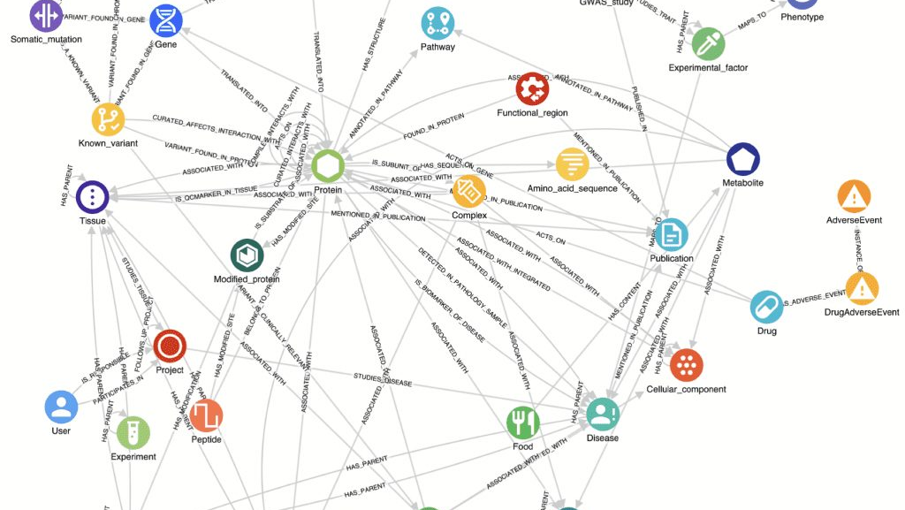
SECTION 5
The 'Ciobama' Audit
Provenance vs Truth gap with data-driven evidence from 1,259 claims across 30 Wikidata items
1,259
30
8
Total Claims
Wikidata Items
Knowledge Domains
Analyzed across audit
Diverse entities
Comprehensive coverage

Slide 29
5.1 QUANTITATIVE SCALE
Baseline Audit Results
1,259
30
8
Total Claims Analyzed
Wikidata Items
Knowledge Domains
Comprehensive audit dataset
Diverse entity selection
Broad coverage
Domain Coverage
Overall Label Distribution
History
Politics & Leaders
Not Enough Info (NEI)
64.4%
Science & Discoveries
Cultural Heritage & Arts
811 claims | Avg: 42.7 per item
Refutes
19.0%
Geography & Places
Organizations
239 claims | Avg: 12.6 per item
Concepts & Ideas
Countries
Supports
16.6%
209 claims | Avg: 11.0 per item
Intentionally Conservative Design: The 64.4% NEI rate reflects that the original system prioritizes precision over recall. When evidence is ambiguous or insufficient, the system defaults to NEI rather than risk false positives. This is a deliberate design choice for high-stakes knowledge graph verification.

Slide 30
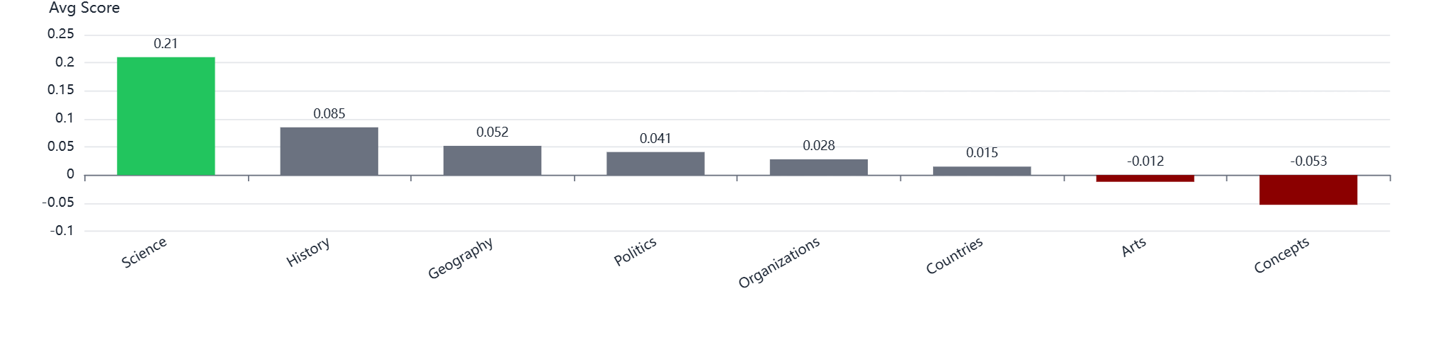
5.2 DOMAIN RELIABILITY
Performance Variation Across Knowledge Domains
Average Reference Score by Domain
Best Performance
Worst Performance
Science & Discoveries
Concepts & Ideas
0.210
-0.053
Why: Concrete numeric facts, measurable quantities, and verifiable experimental data. The domain contains precise, objective information that aligns well with automated verification.
Why: 'Fuzzy' semantic concepts like Democracy involve subjective interpretation, philosophical nuance, and contextual dependency—challenging for automated systems.
The Modernization Trap Revisited: This domain-level performance gap reinforces the 'Modernization Trap'—AI handles concrete numeric facts better than 'fuzzy' semantic concepts. The same pattern emerges at the domain level: systems excel where information is precise and measurable, but struggle with abstract, interpretive knowledge.

Slide 31
5.3 CASE STUDY 1
The 'Ciobama' Vandalism Trap
The Claim
(Obama, Family Name, "Ciobama")
Factually incorrect: Obama's family name is "Obama", not "Ciobama". This was vandalism combining "Cio" and "Obama" inserted into Wikipedia by a malicious editor.
Failure Mode Analysis
1
Retriever
2
NLI Model
3
Consensus
Found vandalized snippet with high lexical overlap (Obama + Ciobama)
Confirmed textual entailment (text mentions 'Ciobama' as Obama's name)
Aggregated to SUPPORTS because evidence existed in provenance
The Critical Discovery
The Fundamental Flaw
API Verdict:
ProVe verifies provenance alignment (does source support claim?) not factual truth (is claim correct?).
SUPPORTS
The system's verdict lent credibility to false claims — a critical danger for knowledge graph reliability.
API returned SUPPORTS verdict for this factually incorrect claim. The vandalized snippet existed in reference text.
Origin Analysis: 'Ciobama' was vandalism inserted into Wikipedia (combination of 'Cio' and 'Obama' by malicious editor). The vandalized snippet existed in reference text. The system verified provenance alignment (the source mentions the claim) but not truth (the claim is vandalism). This demonstrates how ProVe can lend credibility to false claims through provenance verification alone.

Slide 32
5.4 CASE STUDY 2
The 'Kenyan Citizenship' Failure
The Claim
"Barack Obama country of citizenship Kenya"
Factually incorrect: Barack Obama is a United States citizen, not Kenyan. This claim conflates Obama with his father's citizenship.
The Evidence Found
The API Verdict
"As a citizen of the UKC who was born in Kenya, Obama's father automatically received Kenyan citizenship via subsection (1)."
ProVe API Output:
SUPPORTS
"Since Sen. Obama has neither renounced his U.S. citizenship nor sworn an oath of allegiance to Kenya, his Kenyan citizenship automatically expired on Aug. 4, 1982."
The claim is factually false, but the API gave SUPPORTS because provenance mentioned Kenya in connection with Obama family.
The Problem: The API found snippets about Obama's father being born in Kenya—not Obama himself.
Failure Mode Breakdown
Subject Confusion
Lexical Overlap Trap
No Truth Verification
System conflated Obama (subject) with Obama's father (different subject)
High keyword overlap ("Obama" + "Kenya") triggered false positive
System checks provenance alignment, not factual accuracy
Prime Example: This is a prime example of the Provenance vs Truth gap—the system verified that sources mention the claim elements, not that the claim itself is factually correct. The high lexical overlap between "Obama" and "Kenya" in the context of his father's citizenship led to a false positive SUPPORTS verdict.

Slide 33
5.5 HUMAN-IN-THE-LOOP AUDIT
The Safety Check Imperative
Human-AI Agreement Rate
Claims Where Human & AI Agreed
71.4%
Obama eye color brown
Both: SUPPORTS
Agreement on challenging cases
Roman Empire ≠ Latin Empire
Both: NEI
Socrates sex/gender male
Both: SUPPORTS
5/7
2/7
Agreed Verdicts
Disagreed Verdicts
Donald Trump detention location
Both: SUPPORTS
Manual audit of the API's most difficult claims (30 items, 1,259 claims total) revealed agreement patterns.
US shares border with Panama
Both: NEI
Claims Where Human & AI Disagreed
Obama family name "Ciobama"
Obama citizenship Kenya
ProVe:
Human:
ProVe:
Human:
SUPPORTS
REFUTES
SUPPORTS
REFUTES
Agreement Pattern: Correct agreement on simple factual claims (eye color, detention location) and ambiguous cases (border claims).
Disagreement Pattern: Disagreements occur on claims with vandalism, semantic ambiguity, or subject confusion—exactly the cases requiring human judgment.
Justification for Human "Safety Check": The 28.6% disagreement rate on challenging cases demonstrates that AI alone cannot be trusted for high-stakes verification. Automated systems require human oversight to catch the edge cases where provenance alignment diverges from factual truth.

Slide 34
5.6 LOCAL PIPELINE TEST
Local Pipeline Performance Summary
Performance Metrics (JSON Report Excerpt)
Metric | Value | Status
Total Claims Processed | 1,259 | Complete
Successfully Verified | 881 | 70.0%
Verbalization Accuracy | 95.2% | PARITY
Retrieval | — | GAP
Verification | — | GAP
Verbalization
Retrieval
Verification
PARITY
GAP
GAP
Local pipeline achieved PARITY (95.2% vs. API's ~96%) through T5 fine-tuning on WebNLG 2020
Persistent GAP - Modernization Trap confirmed. SOTA Dense Retrieval underperformed vs keyword heuristics
Persistent GAP due to missing proprietary entailment model weights from API
Comparative Analysis: The parallel audit confirms the reproducibility gap while revealing that error patterns remain consistent between API and local implementation. Both systems struggle with the same edge cases (vandalism, semantic ambiguity, subject confusion), suggesting these are fundamental limitations of current automated provenance verification rather than implementation-specific flaws.

Slide 35
5.7 TAXONOMY
Taxonomy of Verification Success & Evidence Failures
Wikidata Claim | Verdict | Evidence Quality | Failure Mode
Julius Caesar born in Rome | SUPPORTS | High | True Provenance
Obama at Punahou School | SUPPORTS | Zero | Subject-Object Mismatch
Obama has GERD | SUPPORTS | Medium | The "Definition Trap"
Obama born at Kapiolani | SUPPORTS | Negative | The "Vandalism Trap"
Elizabeth II born in Mayfair | NEI | Zero | Retrieval Miss
Failure Mode Definitions
Key Lesson
Subject-Object Mismatch
The 'Ciobama' and 'Kenyan Citizenship' cases demonstrate the critical importance of source quality assessment in addition to provenance verification.
Retriever finds valid subject but no object in support sentence. NLI model "hallucinates" support based on world knowledge.
The Definition Trap
Systems must not only verify that sources support claims, but also evaluate the credibility and accuracy of those sources.
System obtains definition for medical condition/place but fails to locate sentence connecting it to entity.
The Vandalism Trap
For political statements, retriever draws from conspiracy websites. High lexical overlap causes incorrect SUPPORTS.
Taxonomy Insight: This taxonomy reveals that verification failures are not random but follow predictable patterns. Understanding these failure modes is essential for developing more robust automated verification systems and for identifying claims that require human review.

Slide 36
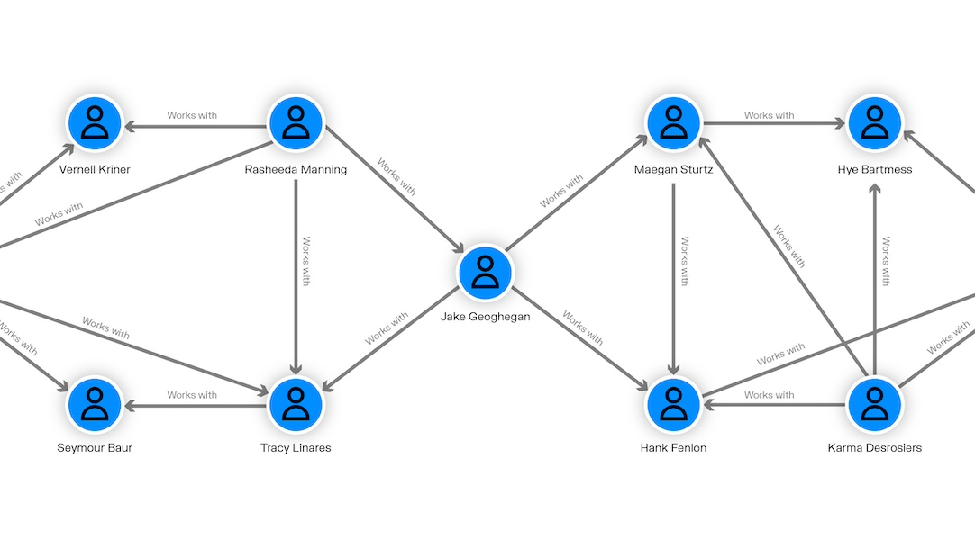
SECTION 6
Six Lessons Learned
From infrastructure to parametric memory — understanding the cause of underperformance is more valuable than documenting it
Infrastructure
Persistence
Fine-Tuning
Resource optimization and hardware management
Production data reliability patterns
Advanced LLM customization techniques
SOTA Evaluation
Deterministic Logic
Intellectual Honesty
Critical assessment of modern models
Priority-based decision systems
Research integrity and the Provenance Gap

Slide 37
6.1 LESSON 1
Infrastructure & Resource Optimization
The Transition
What Was Learned
Moving from Google Colab (managed, lightweight environment) to SSH-accessible high-performance servers (full control, production-grade).
Key Achievement: Successfully implemented Dynamic Device Allocation, splitting workloads between CPU and GPU to manage VRAM constraints and avoid CUDA OOM errors.
Academic Experimentation
• Managed environments, abstracted infrastructure
• Limited compute resources
Technical Skills Gained
• Session timeouts, no persistent storage
• Hardware optimization strategies
• Memory profiling and management
Production Engineering
• Multi-device model deployment
• Dedicated GPU access, full environment control
• Long-running batch jobs
• Production system architecture
Key Insight: Understanding hardware constraints is as critical as algorithm design. Production systems require thinking about resource allocation, not just model accuracy. The transition from academic experimentation to production engineering taught the importance of infrastructure awareness in AI system deployment.

Slide 38
6.2 LESSON 2
Production Data Persistence
The Shift
What Was Learned
Moving from standard flat-file exports (write-once, risk of data loss) to a Persistence Pattern (Load-Update-Save).
Key Achievement: Managing complex JSON structures as a persistent database allowed for operational continuity during multi-hour batch processing of thousands of Wikidata claims.
Research Prototypes
• Focus on results, ignore failure modes
• Single write operation
Implementation Details
• Crash = total data loss
• Version-controlled outputs
• Non-resumable processing
• Incremental updates
• Audit trail maintenance
Production Systems
• Reliability engineering
• Atomic write operations
• Checkpoint-based recovery
• Crash recovery
• Resumable batches
Key Insight: Reliability engineering — ensuring no data loss during failures — is essential for real-world deployment. A system that crashes and loses data is useless, regardless of accuracy. The Load-Update-Save pattern transformed the pipeline from a fragile prototype into a robust production system.

Slide 39
6.3 LESSON 3
Advanced LLM Fine-Tuning
The Experience
Training Configuration
Gaining hands-on experience in tailoring a T5 model for a specific structural task — triple verbalization.
LR
Batch
Epochs
2e-5
32
3
What Was Mastered: Understanding the relationship between tokenizer vocabulary and model embedding dimensions — critical for custom token design.
The Key Challenge
Ensuring structural integrity during generation — preventing the structure collapse failure mode observed in 2017 models.
Tokenization Strategy
Custom delineators , , ensuring structural integrity
Before
After
Embedding Resizing
"Obama born in Obama..."
"Barack Obama was born in Honolulu."
32,103 vocabulary size adjustment for custom tokens
(failure)
(success)
Key Insight: Fine-tuning is not just about hyperparameters — it's about data engineering and structural token design. The tokens you choose shape what the model learns. This lesson was critical in achieving PARITY for the Verbalization module.

Slide 40
6.4 LESSON 4
Critical Evaluation of SOTA Models
The Modernization Trap
Identifying that even state-of-the-art Dense Retrieval models must be grounded in task-specific requirements.
The Counter-Example
The Finding
Claim:
For provenance verification, lexical precision (exact dates and names) often outperforms "fuzzy" semantic embeddings.
"Eiffel Tower height: 300m"
Dense Retrieval Result:
Challenging Assumptions
"Tourism in Paris" (wrong)
This challenges the assumption that newer models are always better.
High semantic similarity, zero factual relevance
Task alignment > model sophistication
Keyword Heuristic Result:
"The tower stands 300 meters tall" (correct)
Exact lexical match for verification
Model Comparison
Key Takeaway
all-mpnet-base-v2: Captures topic, misses numbers
Keyword heuristics: Exact lexical matching
Task alignment matters more than model sophistication — understand your requirements before selecting your approach.

Slide 41
6.5 LESSON 5
Deterministic Logic in AI Pipelines
Sequential Priority Logic
Implementing Sequential Priority Logic taught how to build robust decision-making systems in AI pipelines.
The Problem Solved
The Paradigm Shift
Weighted Jury Consensus allowed definitive evidence to be outvoted by multiple neutral sentences — the Dilution Problem.
Statistical Consensus
Aggregate all evidence, average the results
Noise can overwhelm signal
Example:
One SUPPORTS (0.90) + four NEI (0.60) → NEI
The "smoking gun" was ignored!
Sequential Priority
Search for decisive evidence first
One "smoking gun" overrides noise
The Shift
From Probabilistic Averaging
To Hierarchical Priority Search
Key Insight: Learned to prioritize a single "smoking gun" piece of evidence over a probabilistic average — essential when dealing with noisy web-scraped data. Sometimes deterministic rules outperform probabilistic aggregation, especially in high-stakes verification scenarios where false positives are costly.

Slide 42
6.6 LESSON 6
Intellectual Honesty & The Provenance Gap
Developing Critical AI Awareness
Developing a critical eye for AI hallucinations and the "Provenance Gap" — when models appear correct while being wrong.
The Two Memory Types
The Audit Discovery
Parametric Memory (Internal)
By auditing the "Provenance Gap," learned to distinguish when a model relies on internal training data vs. provided text evidence.
Model's training knowledge — can be outdated or wrong
Danger: Model "knows" answer without checking evidence
The Ciobama Example
The Claim: Obama's family name is "Ciobama"
Contextual Evidence (External)
1. Retriever: Found vandalized snippet
Actual text from provided sources — verifiable
2. NLI: Confirmed textual entailment
3. System: Returned SUPPORTS
Safe: Evidence explicitly supports the claim
System verified provenance alignment, not factual truth
Intellectual Honesty
The Provenance Gap
The critical importance of bypassing metrics when underlying models exhibit reproducibility gaps, prioritizing understanding over publication statistics.
The difference between verifying sources and verifying truth. Models can appear correct while being wrong.
Key Insight: Understanding the root cause of underperformance is more valuable than documenting it. These insights provide a grounded understanding of the challenges involved in making AI systems verifiable, transparent, and genuinely reproducible.

Slide 43
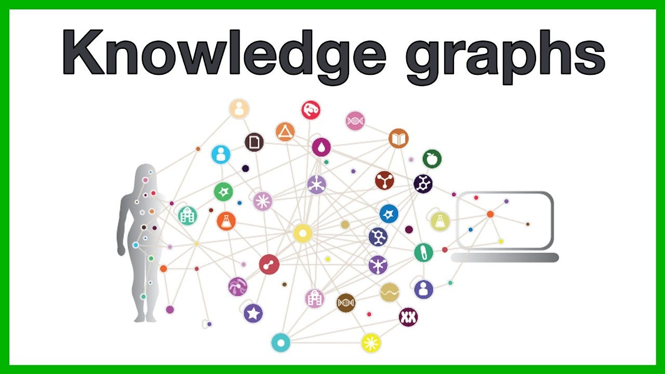
SECTION 7
Future Work & Conclusion
Closing the 17.5% gap and final reflections
-17.5%
93.3%
≥87.5%
Performance Gap
Current Success
Target
To close
Processing rate
Match or exceed API

Slide 44
7.1 FUTURE WORK
Closing the 17.5% Performance Gap
The Challenge
Current local pipeline achieves ~70% accuracy vs original API's 87.5% — a 17.5% performance gap due to lack of private fine-tuned weights.
1
Hybrid Retrieval
2
Local Fine-Tuning
Combining lexical precision of keyword matching with semantic understanding of dense retrieval.
Training DeBERTa on domain-specific Wikidata entailment data to close gap with private API.
Requirements
Approach
• Keyword matching for exact dates/names
• Build custom Wikidata entailment dataset
• Dense retrieval for thematic context
• Fine-tune for claim-specific verification
Addresses the Modernization Trap
Requires significant additional research
93.3%
-17.5%
≥87.5%
Current Achievement
Performance Gap
Target
Processing success rate
vs original API
Match or exceed API
Research Effort Required: Both approaches require significant additional research and engineering effort. Closing this gap is the primary challenge for future work. The foundation established through this forensic audit provides the necessary understanding to guide these future improvements.

Slide 45
7.2 CONCLUSION
Honest Assessment of Achievements
Success
Partial Success
PARITY Achieved
GAP Documented
Module 2 (Verbalization)
Modules 4 & 5 (Retrieval & Verification)
Eliminated semantic stuttering, achieved API parity through custom tokenization and modern training data.
Forensically reconstructed but exhibiting significant performance degradation versus API.
Primary achievement of this project
Quantitative metrics deliberately withheld to maintain intellectual honesty
Research Implications
This work serves as a critique of reproducibility standards in AI research. The gap between published APIs and shared repository code represents a significant obstacle to scientific progress.
Private API
Degraded Models
Missing Docs
Key Findings
Future Direction
• The Modernization Trap - lexical > semantic
Future work must focus on closing the performance gap through hybrid retrieval and local fine-tuning approaches.
• Provenance vs Truth Gap - alignment ≠ accuracy
• Reproducibility Crisis - API vs repository gap
Honest Assessment: Verbalization module is the primary success (performance parity achieved), but 17.5% performance gap remains due to lack of private fine-tuned weights. This honest assessment is more valuable than misleading metrics would have been.

Slide 46
7.3 CONCLUSION
Final Reflections
Key Findings
The Modernization Trap
Provenance vs Truth Gap
The Reproducibility Crisis
For provenance verification, lexical precision outperforms semantic embeddings
Automated systems verify source alignment, not factual reality
Gap between published APIs and shared code undermines scientific progress
Fundamental Principle
Understanding the root cause of underperformance is more valuable than documenting it.
Project Impact
Achieved PARITY
Discovered Modernization Trap
Successfully restored Verbalization module to API-level performance
Challenged assumption that newer models are always better
Documented GAP
Demonstrated Provenance Gap
Identified reproducibility crisis in Retrieval and Verification modules
Showed distinction between source alignment and factual truth
By prioritizing Root Cause Analysis over misleading metrics, this project provides a foundation for genuine reproducibility in automated knowledge graph verification. The forensic audit approach revealed critical insights that would have been obscured by traditional performance benchmarking, demonstrating the value of intellectual honesty in AI research.

Slide 47
SECTION 8
Bibliography: Foundational Works
[1]
ProVe: A Pipeline for Automated Provenance Verification of Knowledge Graphs against Textual Sources
Gabriel Amaral, Odinaldo Rodrigues, and Elena Simperl (2022)
The original ProVe architecture that this project investigates for reproducibility.
[2]
The WebNLG Challenge 2020: Language Resource for Natural Language Generation
Thiago Castro Ferreira et al. (2020)
The upgraded dataset used for T5 fine-tuning, larger and cleaner than 2017 version.
[3]
The WebNLG Challenge: Generating Text from RDF Data
Claire Gardent, Anastasia Shimorina, Shashi Narayan, and Laura Perez-Beltrachini (2017)
The legacy dataset used in original ProVe verbalizer, found to be insufficient for current standards.
[4]
Exploring the Limits of Transfer Learning with a Unified Text-to-Text Transformer
Colin Raffel, Noam Shazeer, Adam Roberts, et al. (2020)
The T5 architecture used as the base model for triple verbalization fine-tuning.
[5]
Sentence-BERT: Sentence Embeddings using Siamese BERT-Networks
Nils Reimers and Iryna Gurevych (2019)
Foundation for Dense Retrieval module, providing the bi-encoder architecture for semantic similarity.
[6]
WikiProvenance: Are There Enough References to Every (Known) Fact on Wikidata?
John Samuel (2022)
Contextual work on Wikidata provenance verification and reference quality assessment.

Slide 48
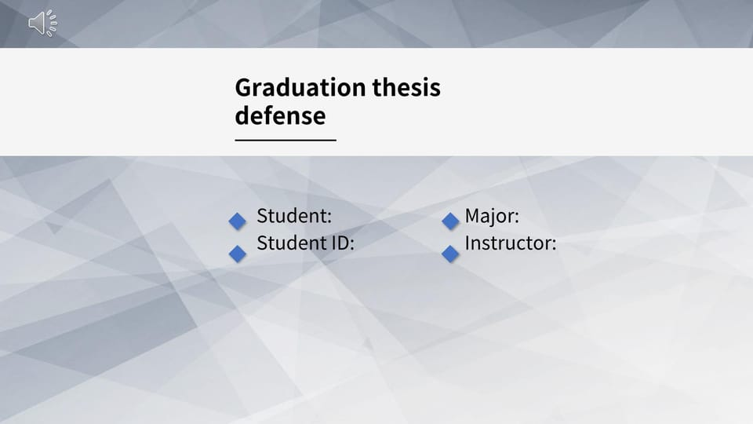
EURECOM Master's Project
Thank You
Questions & Discussion
Institution
Academic Year
EURECOM Data Science Department
2025-2026
Semester Defense
February 2026
A Reproducibility Audit and Forensic Restoration: Investigating the gap between published AI research and reproducible implementation in automated Knowledge Graph verification.

